Slide 1

Ménage Financing
GROUP B : Home Loans

Slide 2
Development Team
Frontend
Developers
KANISHKA KHANDELWAL
POOJA
BHARDWAJ
MANASA J
Backend
Developers
HARSH ANAND
ABHAY
PANDAY
SAHIL
TEJA

Slide 3
TECHNOLOGY STACK
The Technology stack is a combination of programming languages, frameworks, and tools that developers use to build a web or mobile app.
The two main components of any app are client-side (front-end) and server-side (back-end).
The Technologies used in our Project are as follows :
HTML
CSS
MYSQL
JAVA
ANGULAR
BOOTSTRAP
SPRING BOOT

Slide 4
KEY FEATURES
Home Page:
EMI Calculator
Register User
Login User
Register User:
Form Validation
Email Notification
Login User:
Form Validation
Forget Password
User Profile:
Validation
User Dashboard:
EMI Chart
Payment Option
Edit Loan
Apply Loan:
Cibil Score
Loan Tenure Validation
One Active Loan at a time
Edit Loan:
Cibil Score
Loan Tenure Validation
Amount Constraints
Payment Gateway:
Form Validations
OTP (on registered mail)
Admin Dashboard:
Search by Name
Search by LoanID
View all Loans
Admin Approval:
View Loan Details
Accept Loan
Reject Loan (with reason)

Slide 5
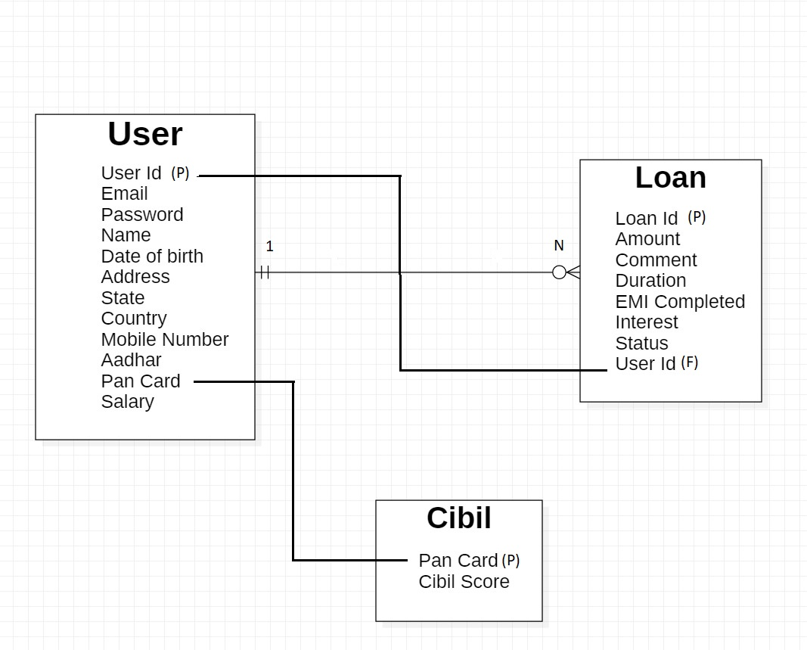
TABLE

Slide 6

OVERVIEW OF OUR PROJECT Home Loans Ménage Financing

Slide 7
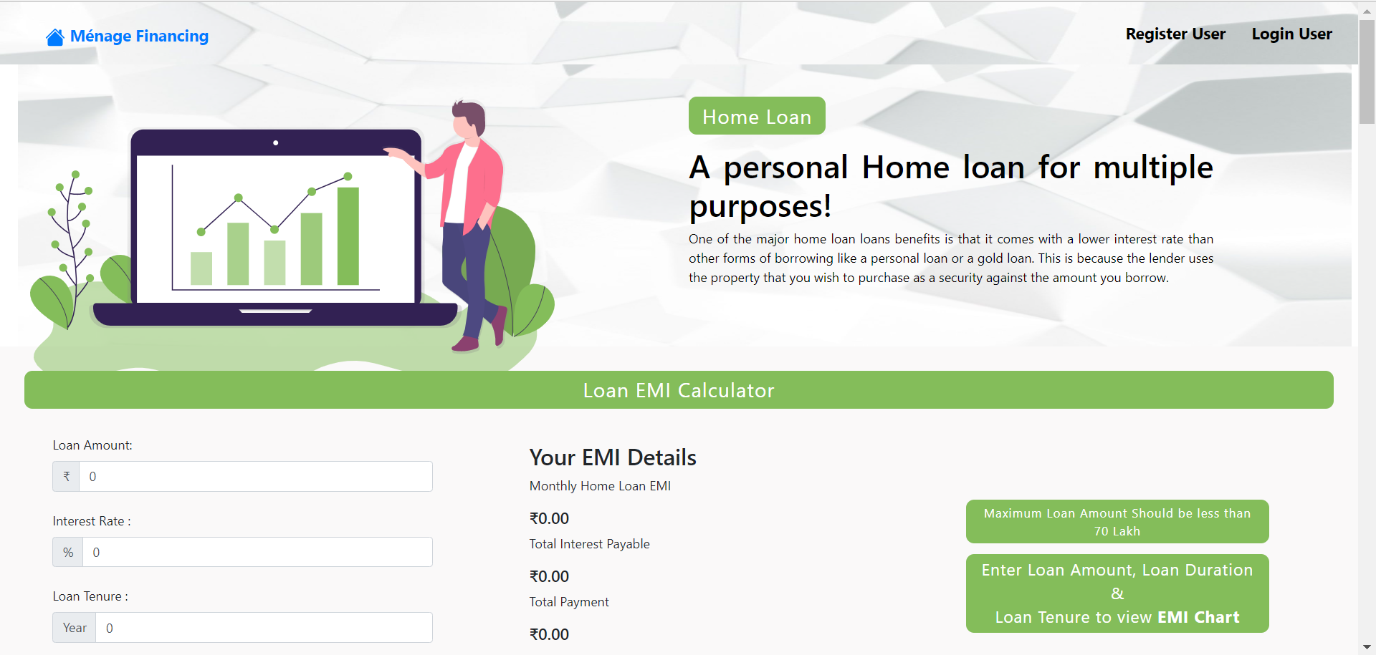

Slide 8
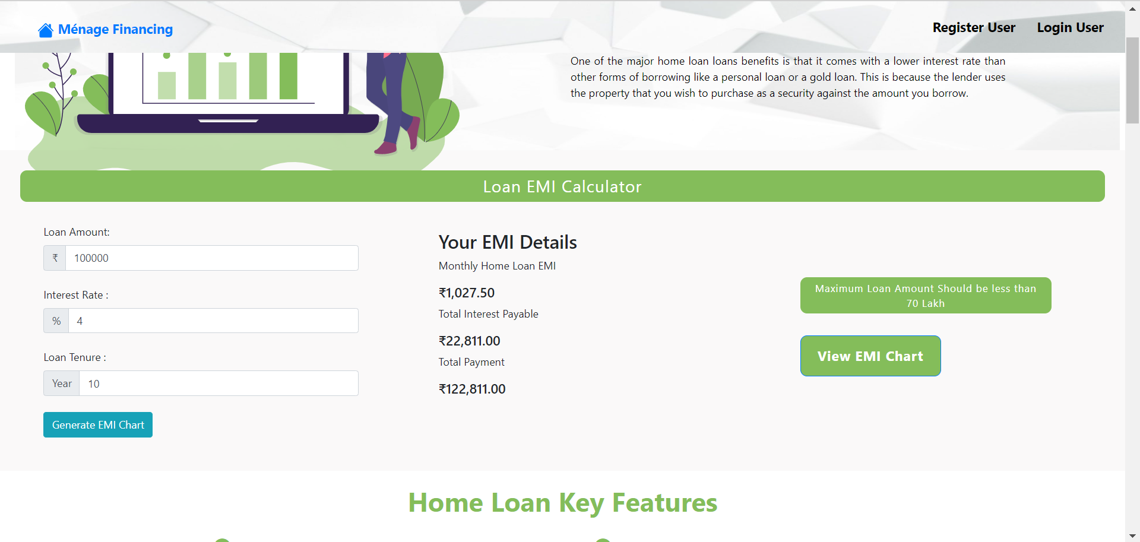

Slide 9
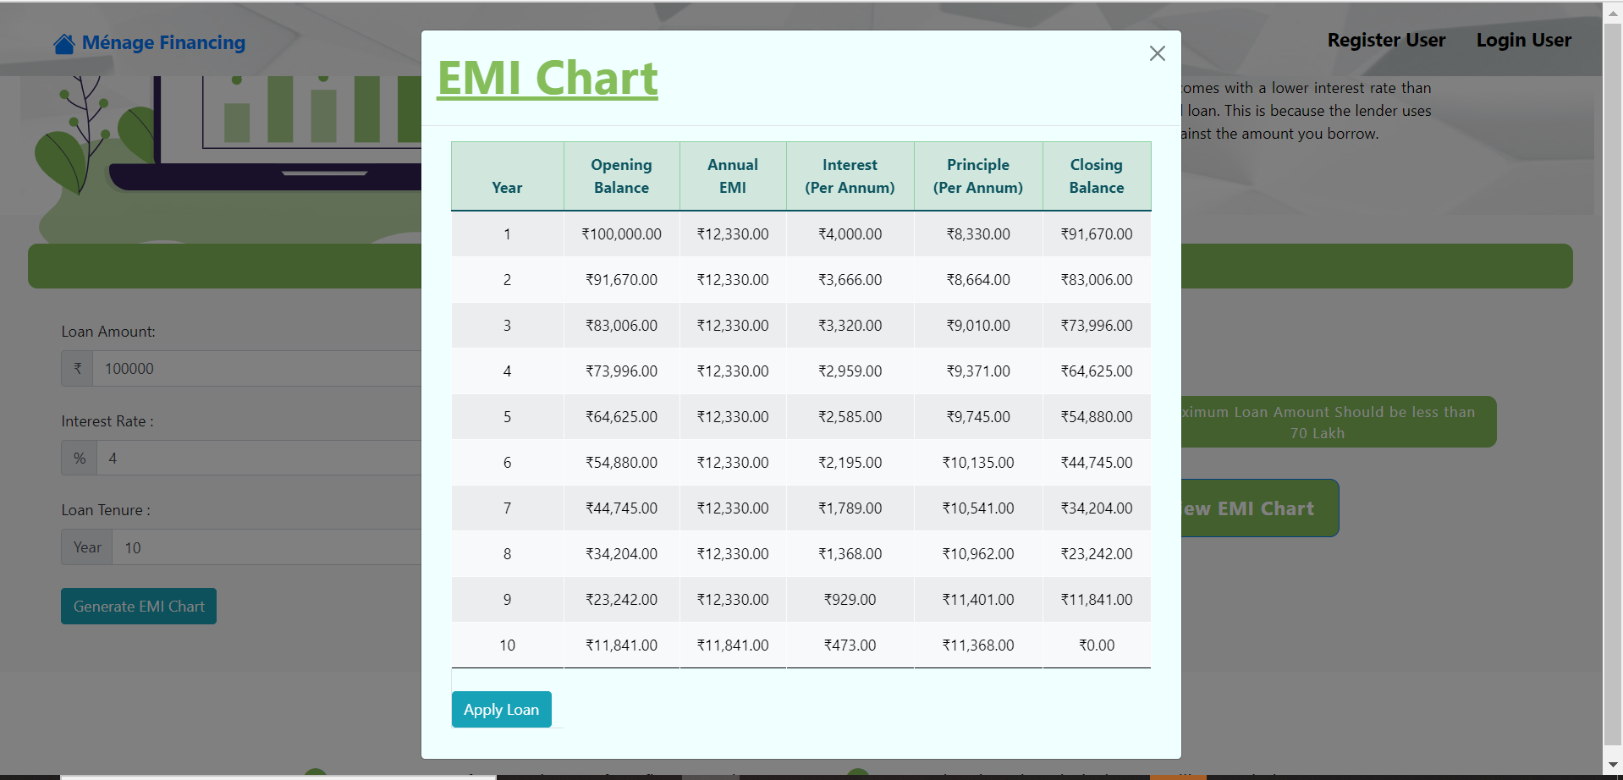

Slide 10
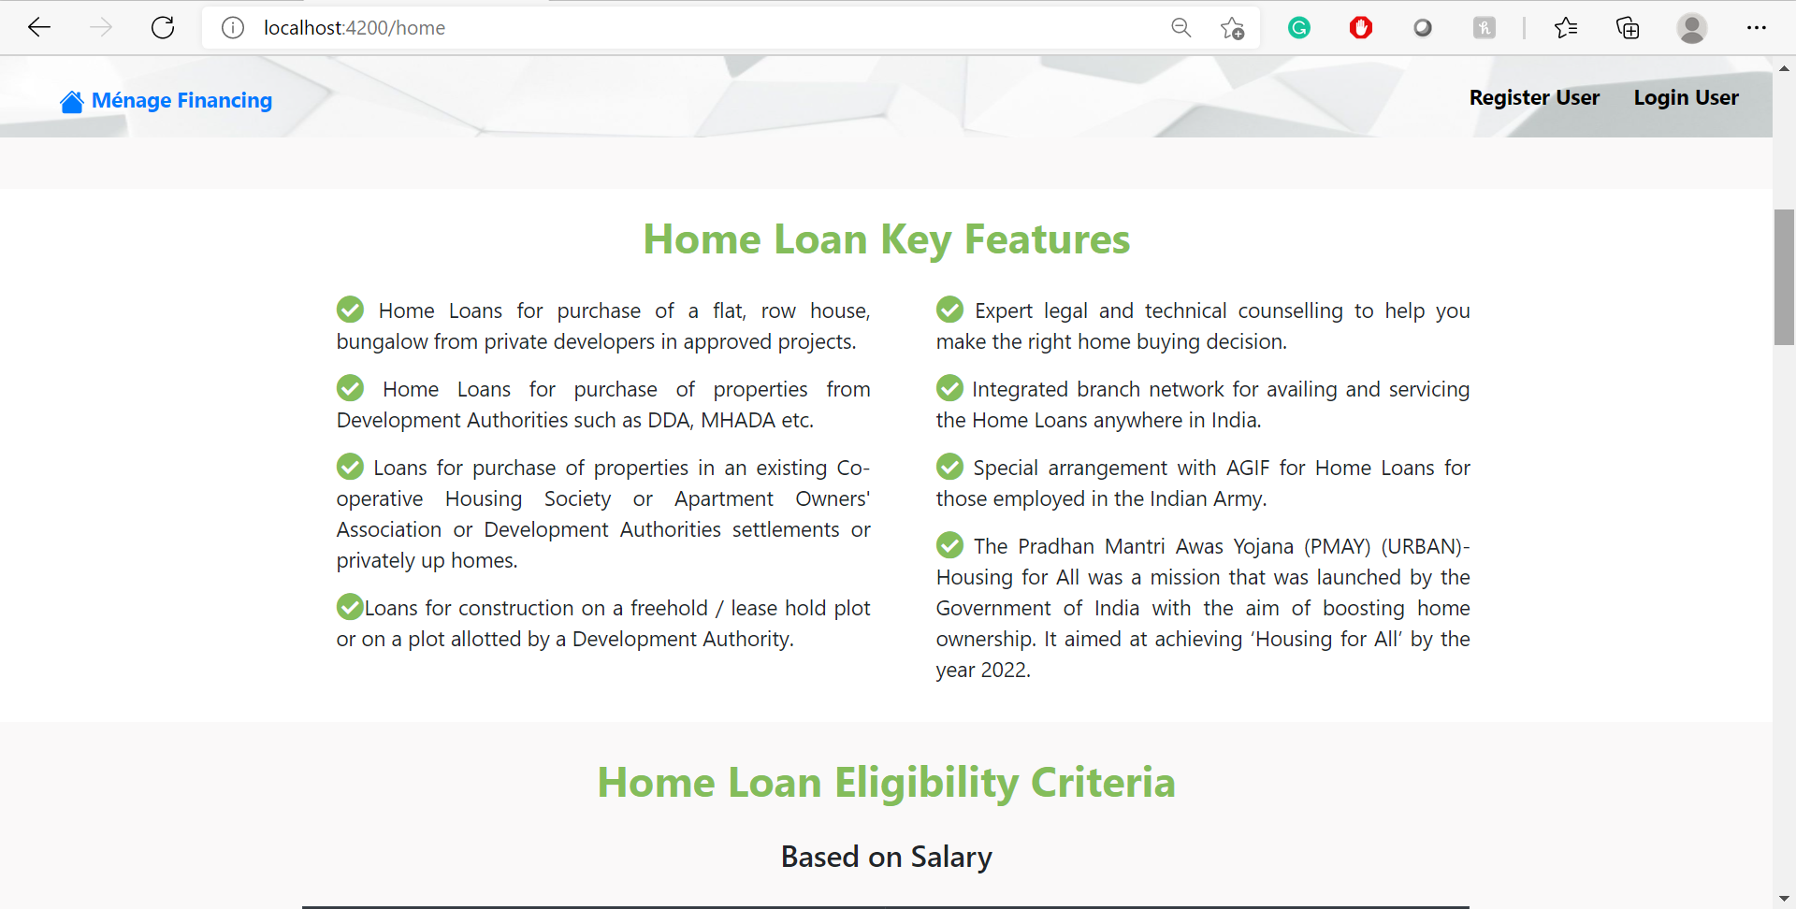

Slide 11
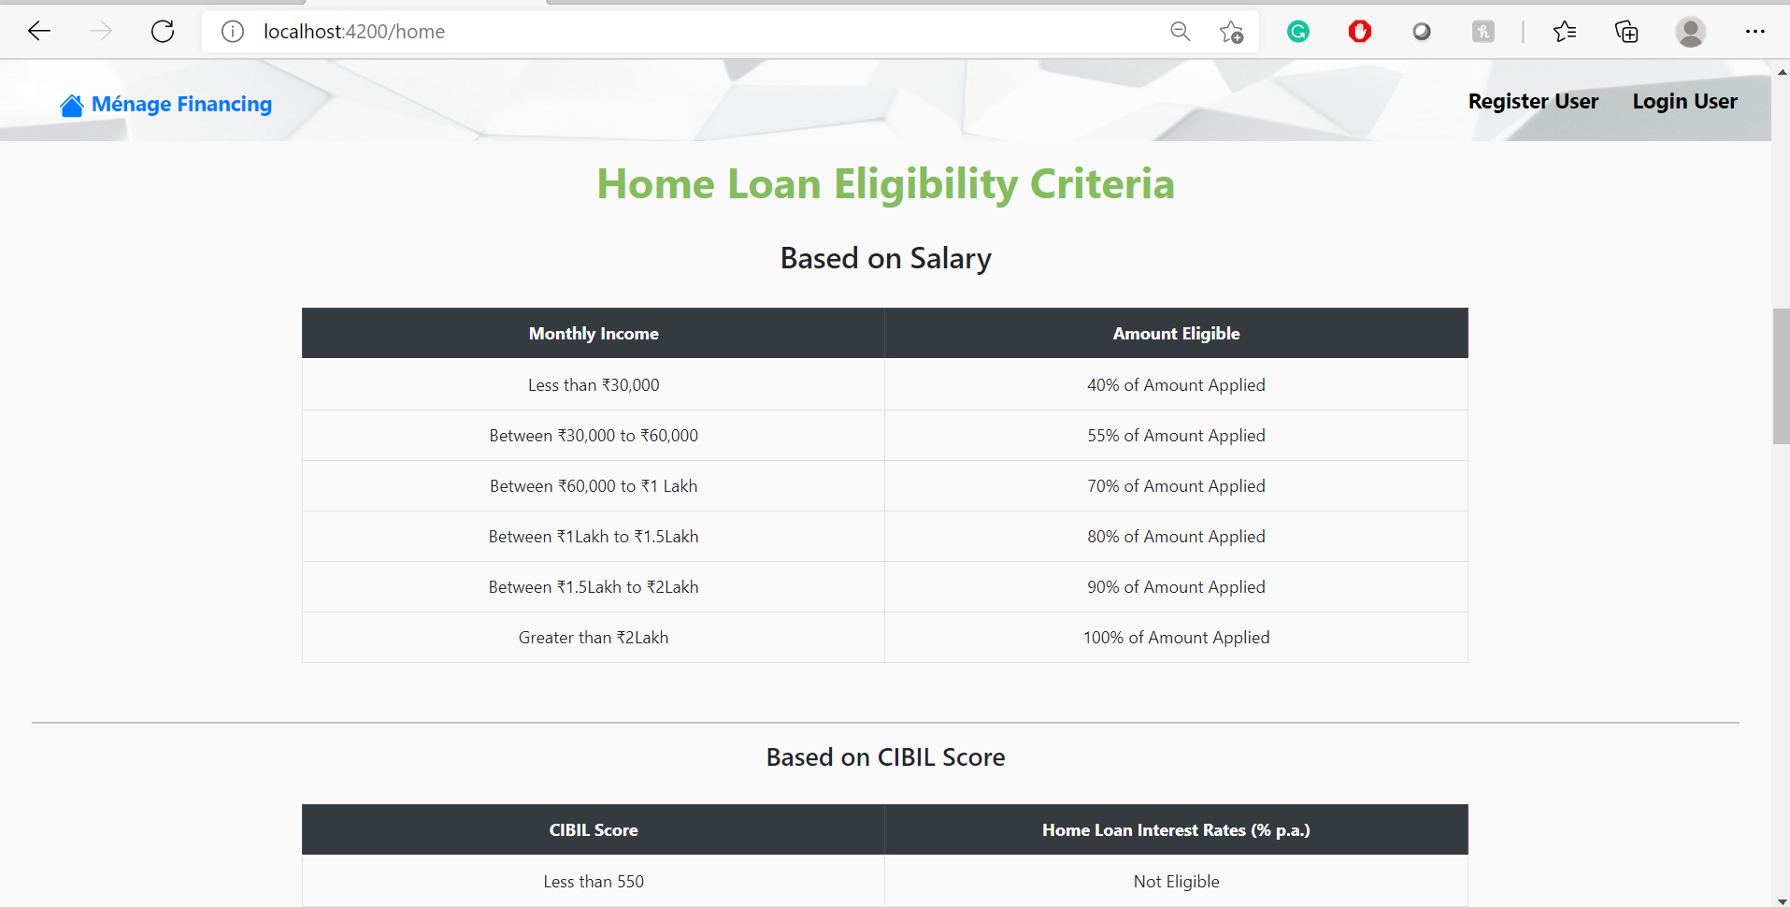

Slide 12
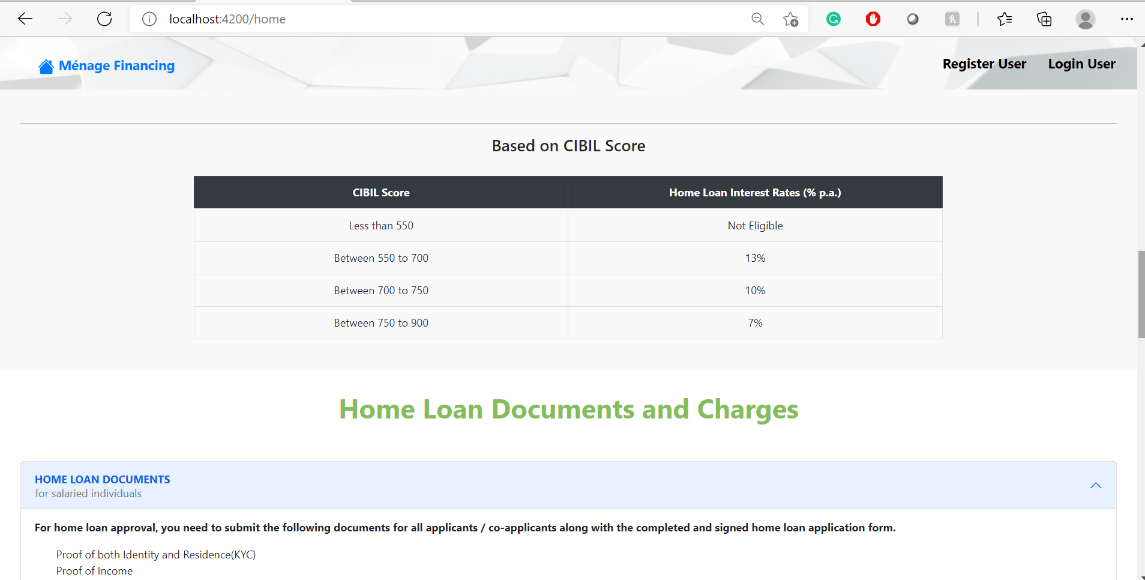

Slide 13
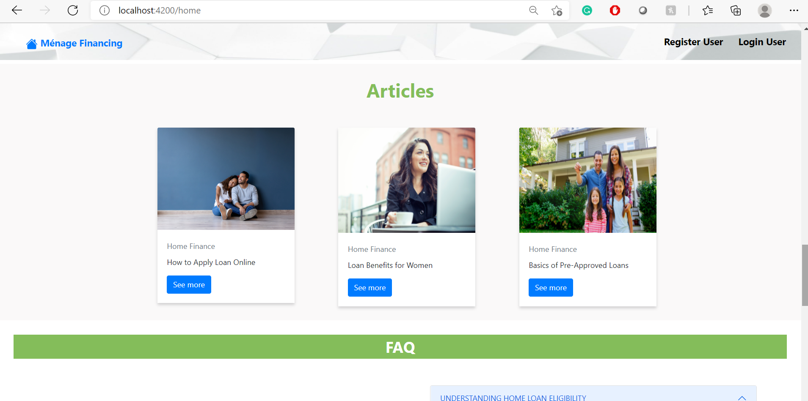

Slide 14
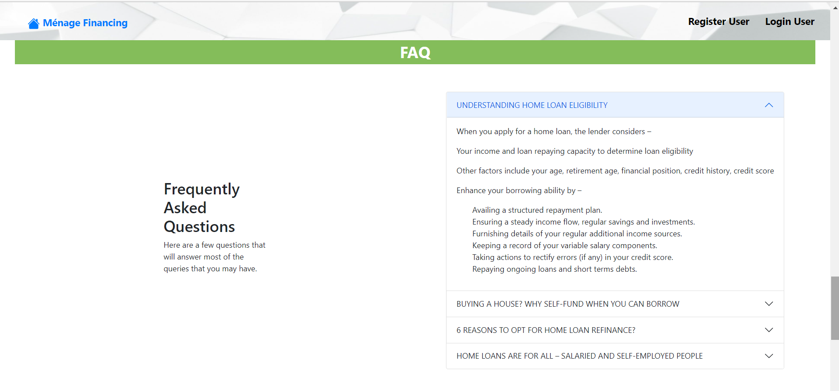

Slide 15
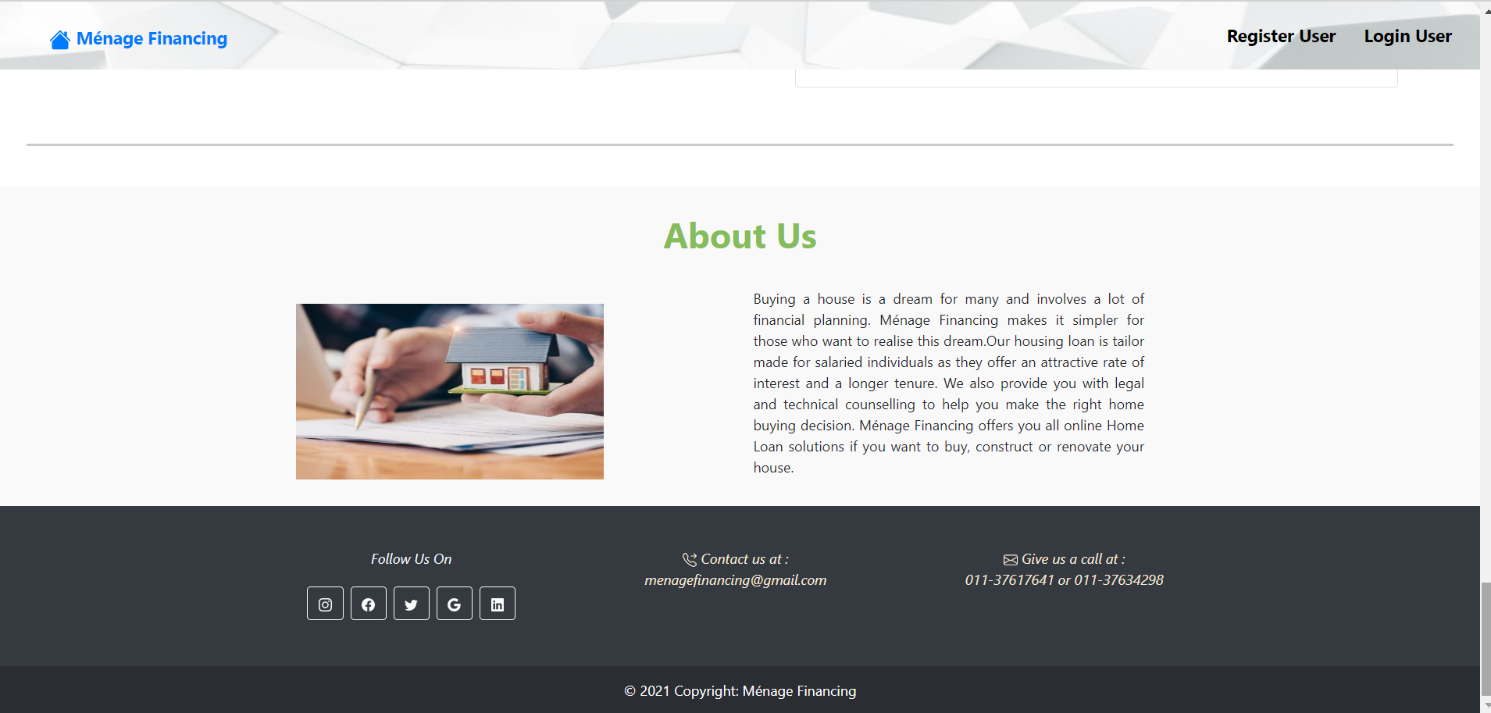

Slide 16
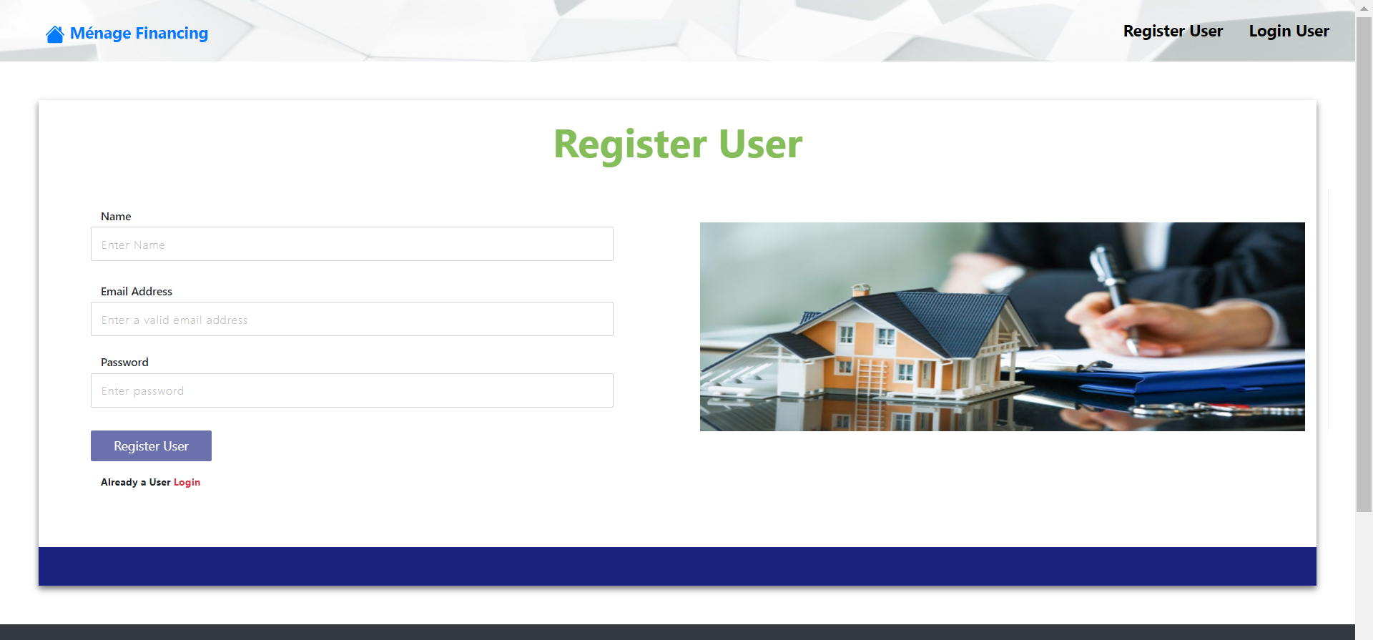

Slide 17
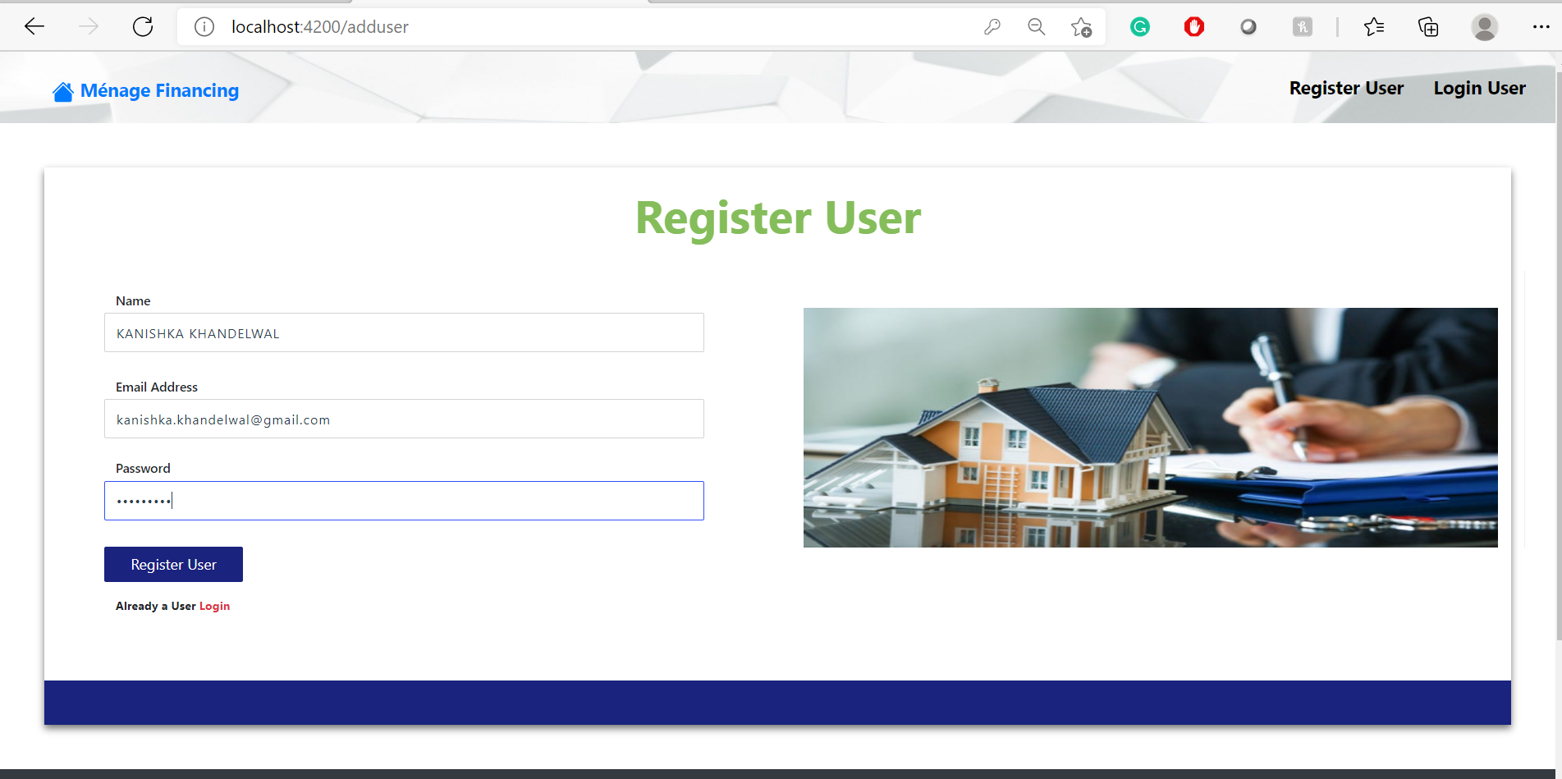

Slide 18
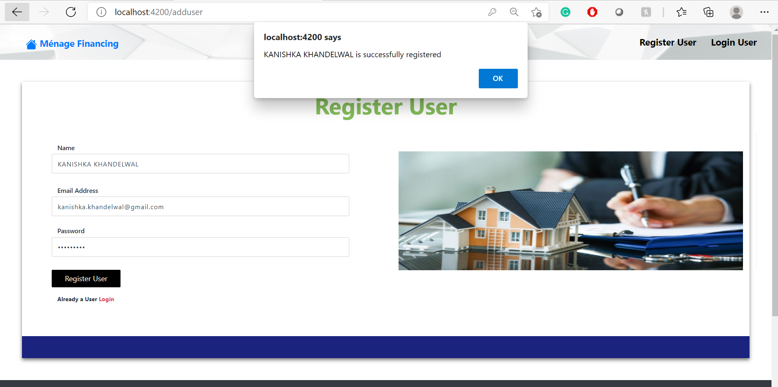

Slide 19
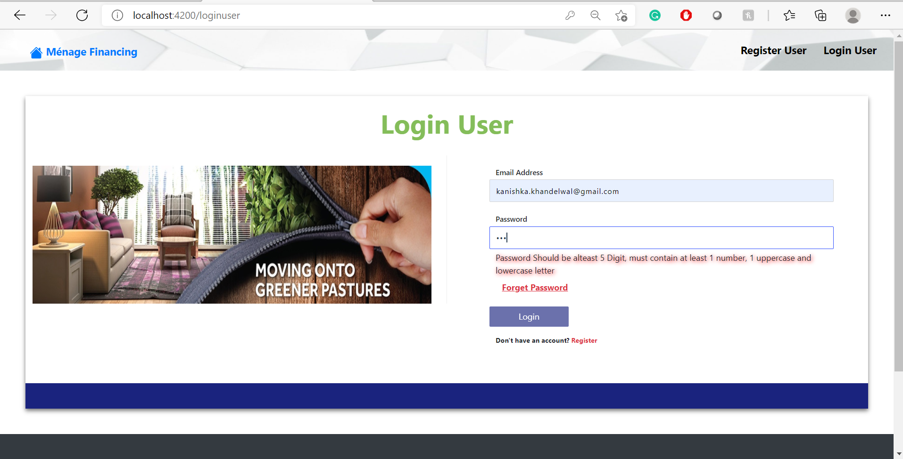

Slide 20
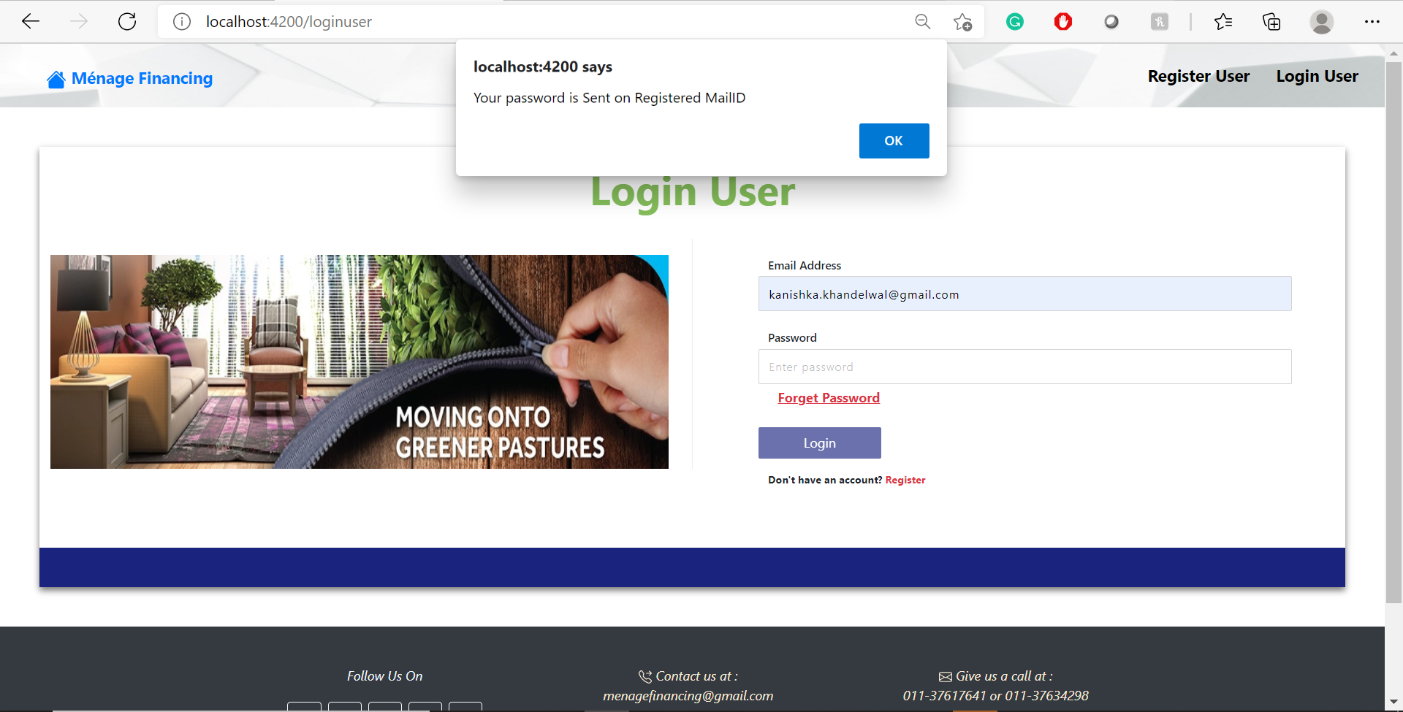

Slide 21
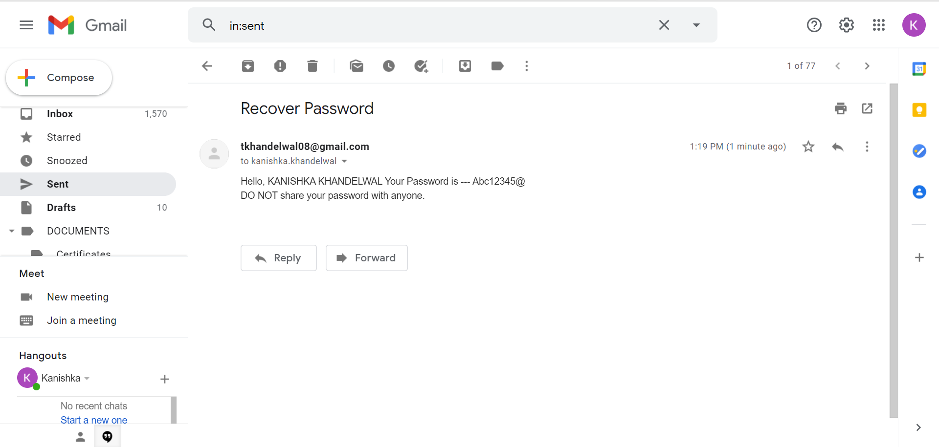

Slide 22
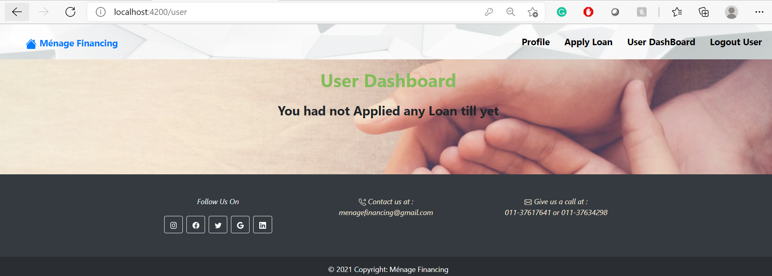

Slide 23
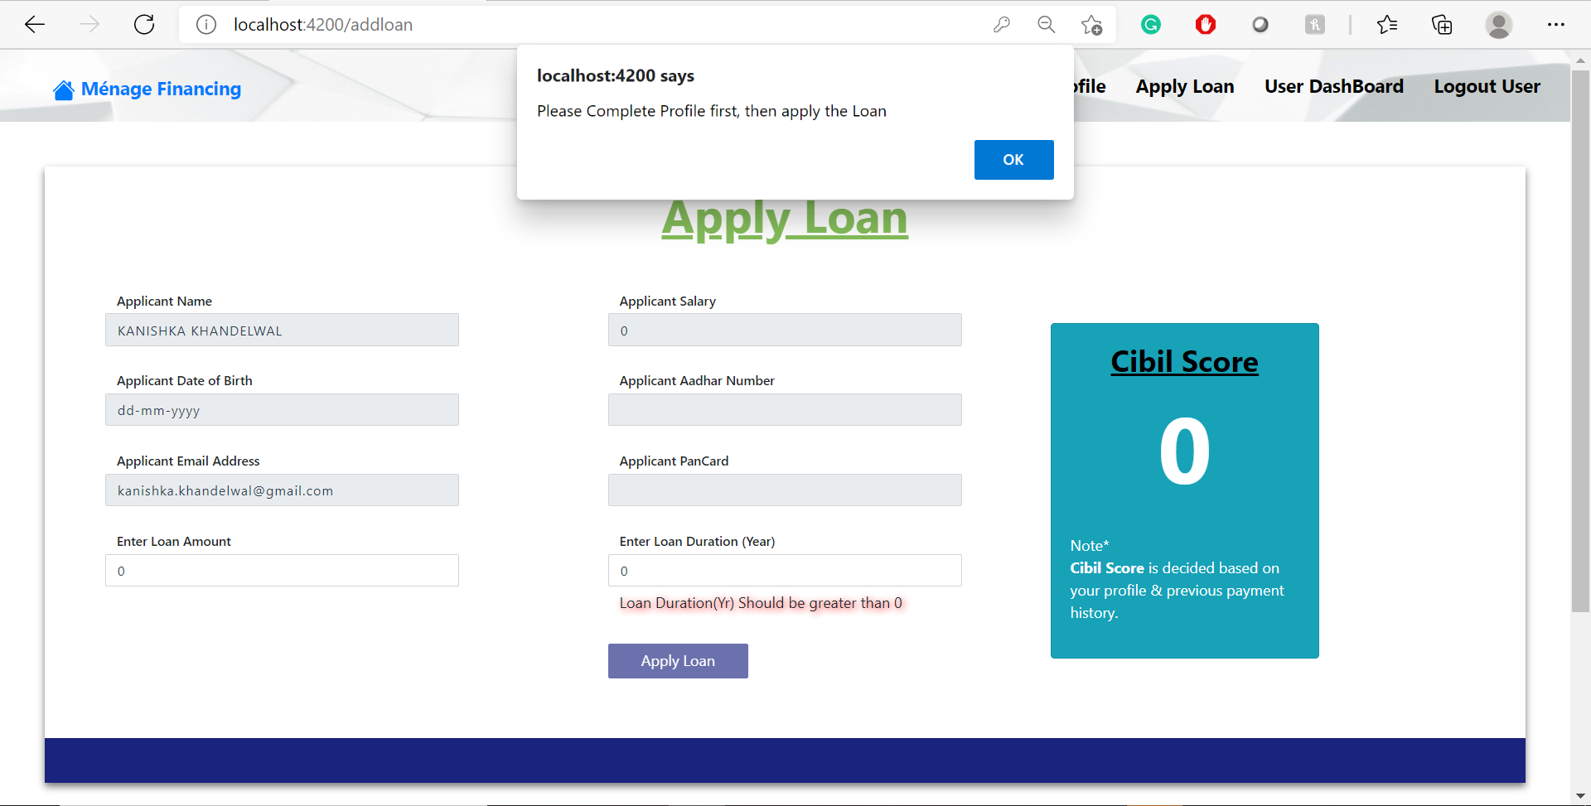

Slide 24
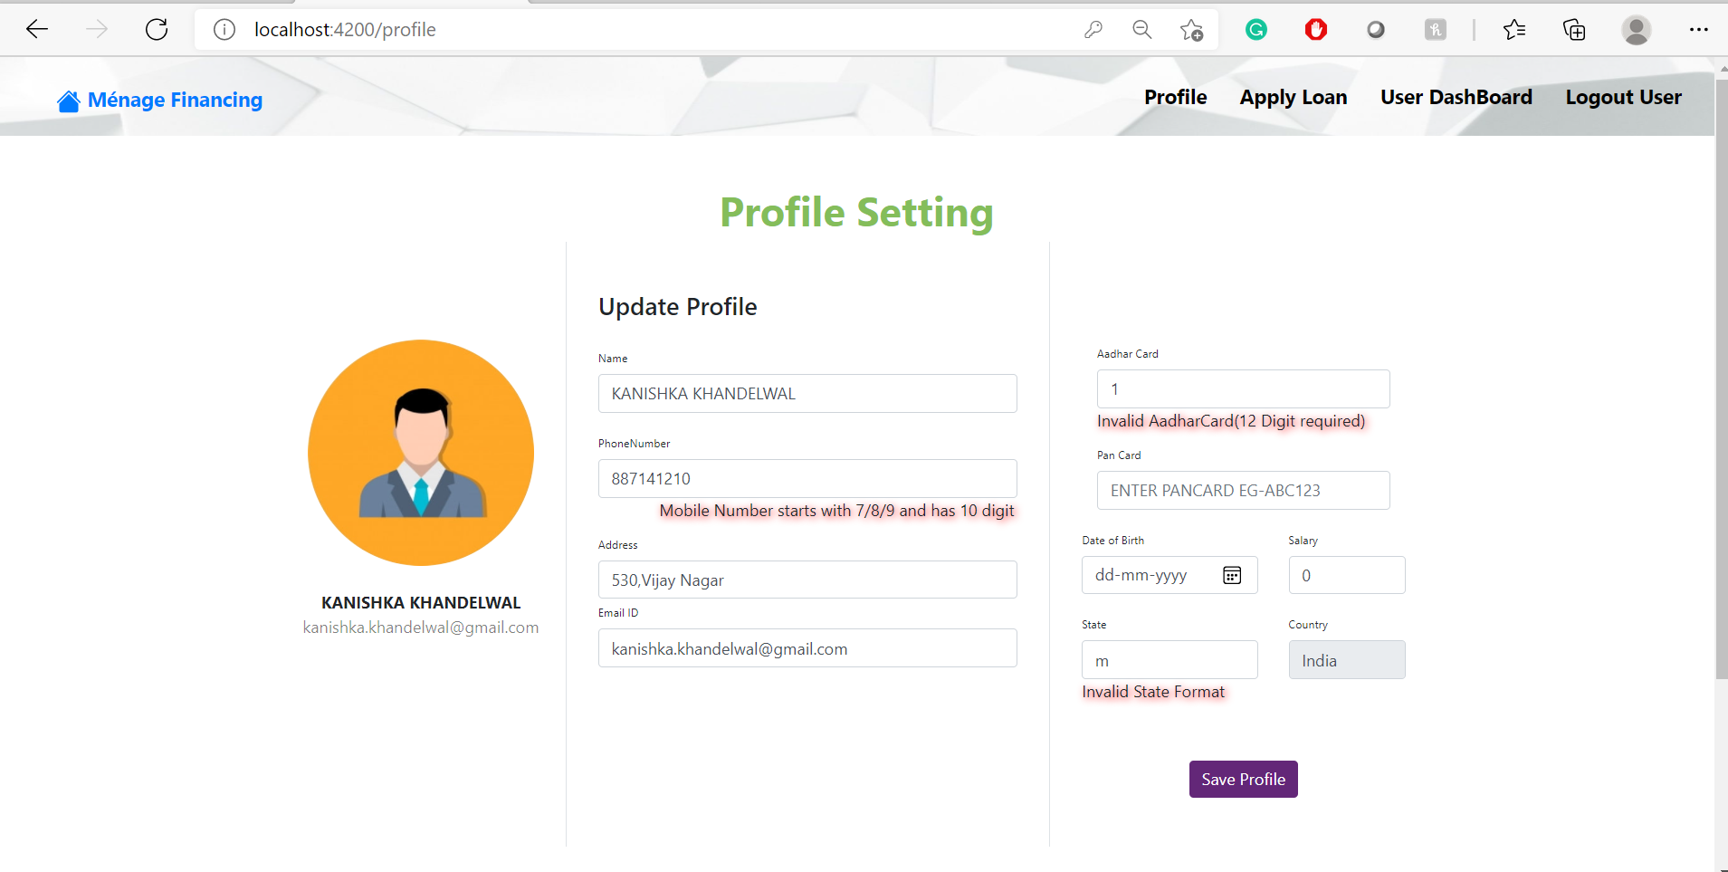

Slide 25
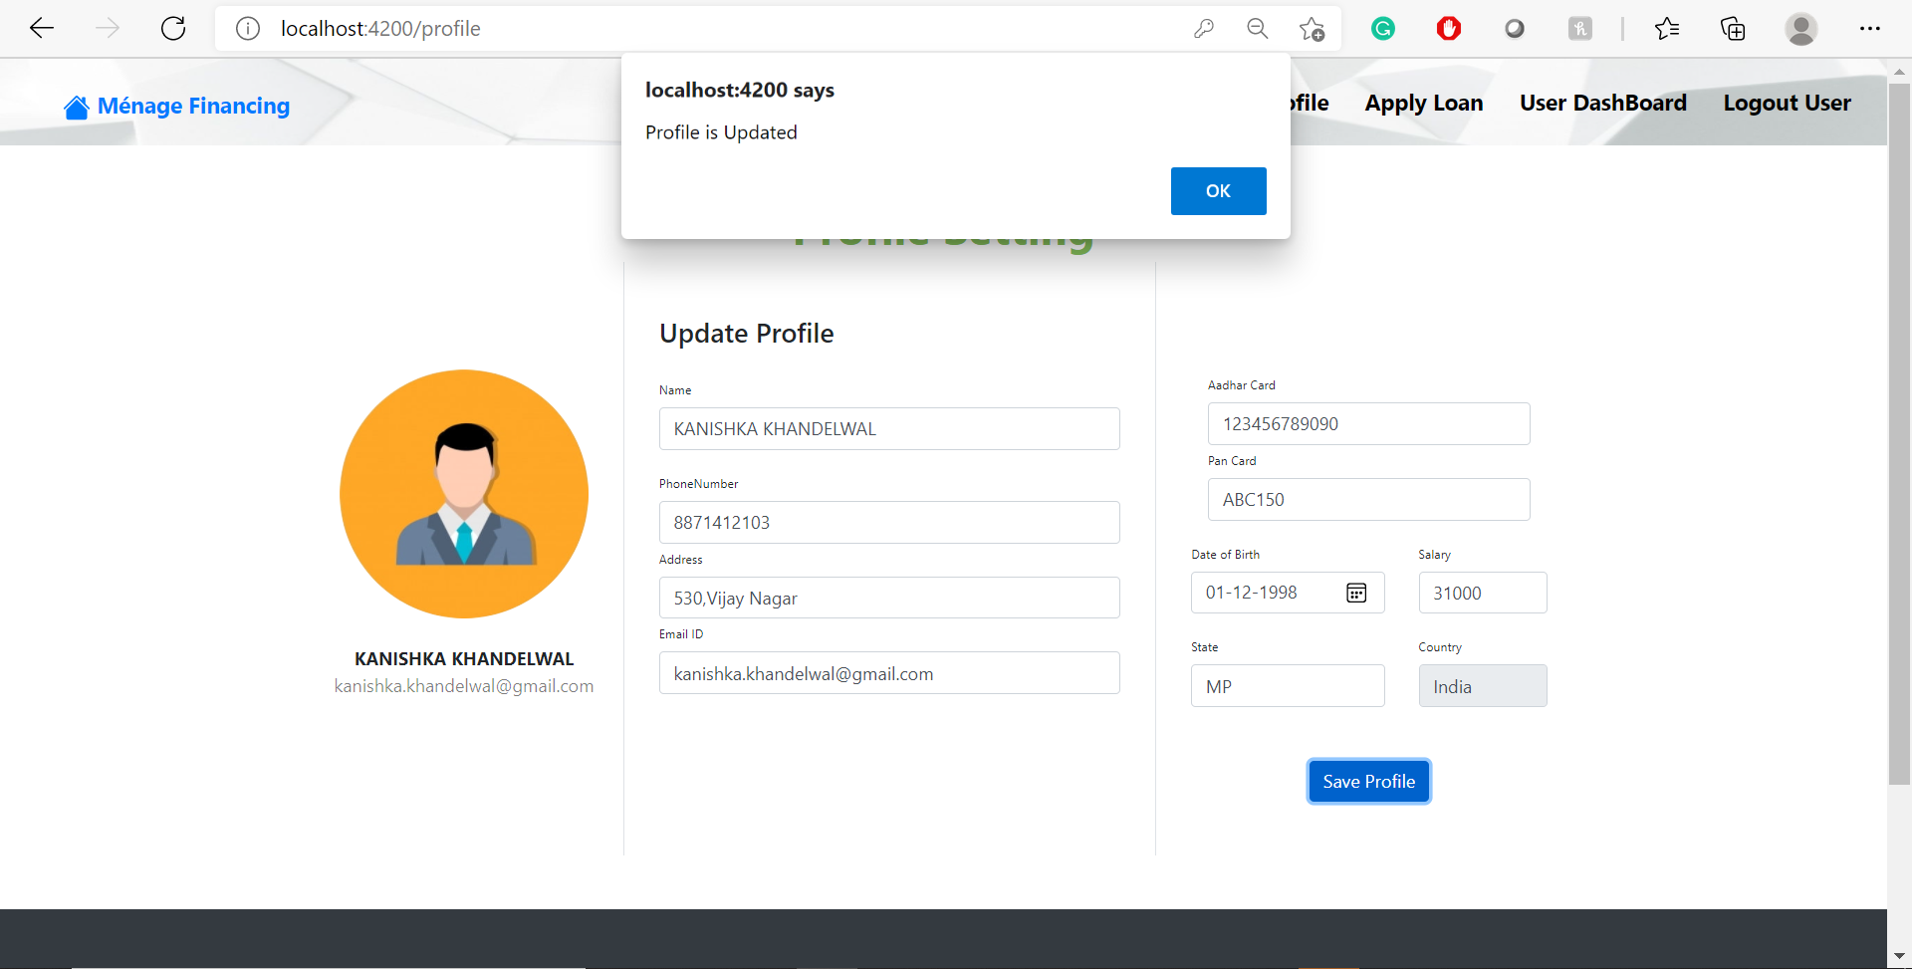

Slide 26
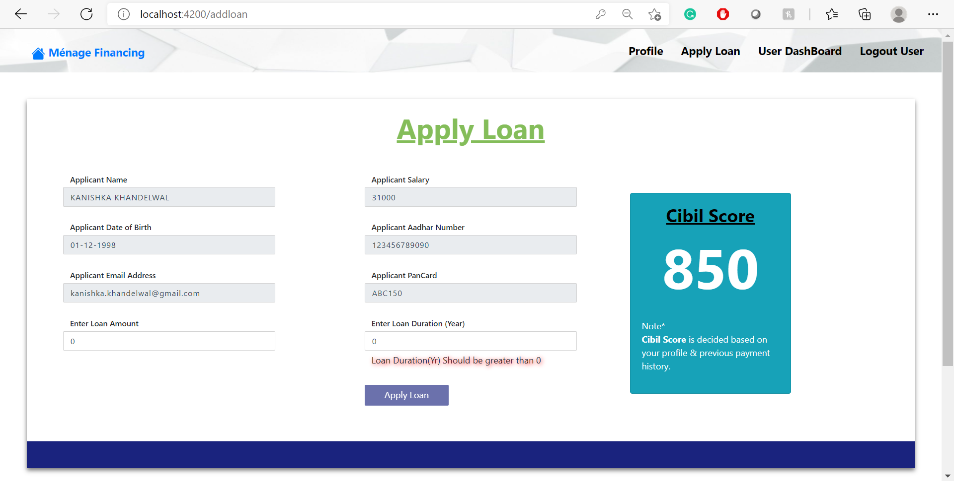

Slide 27
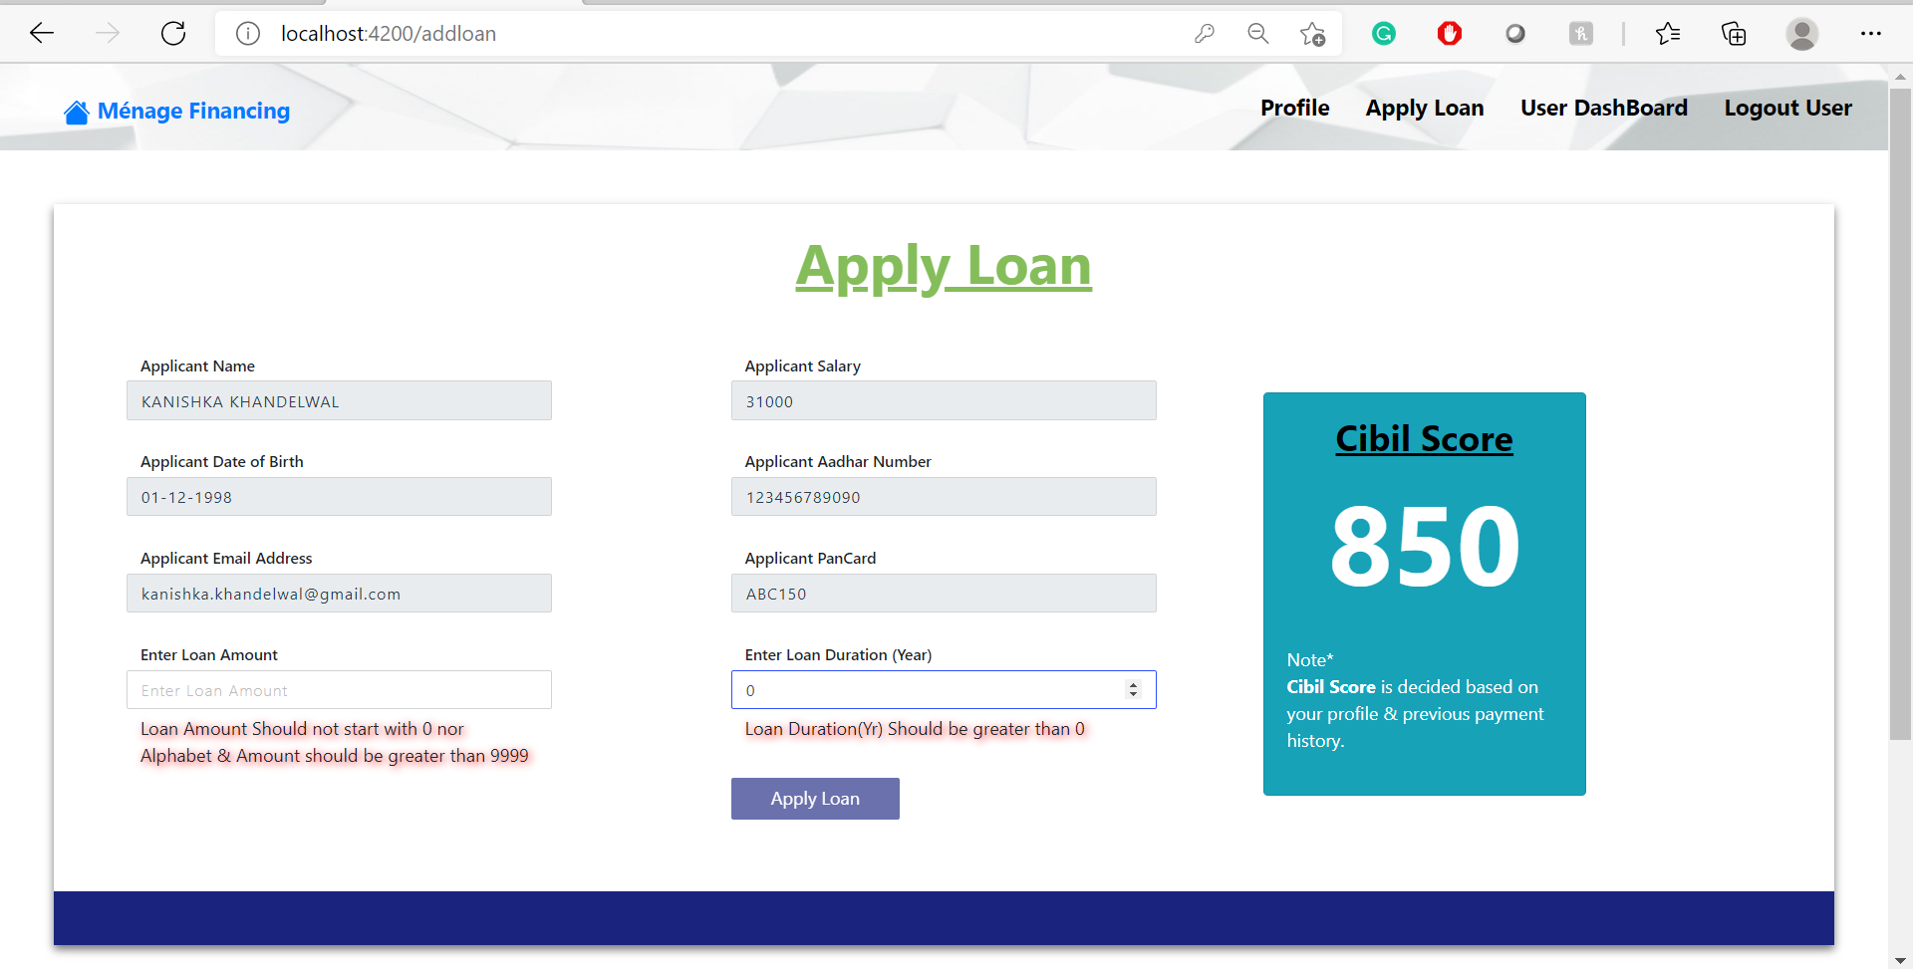

Slide 28
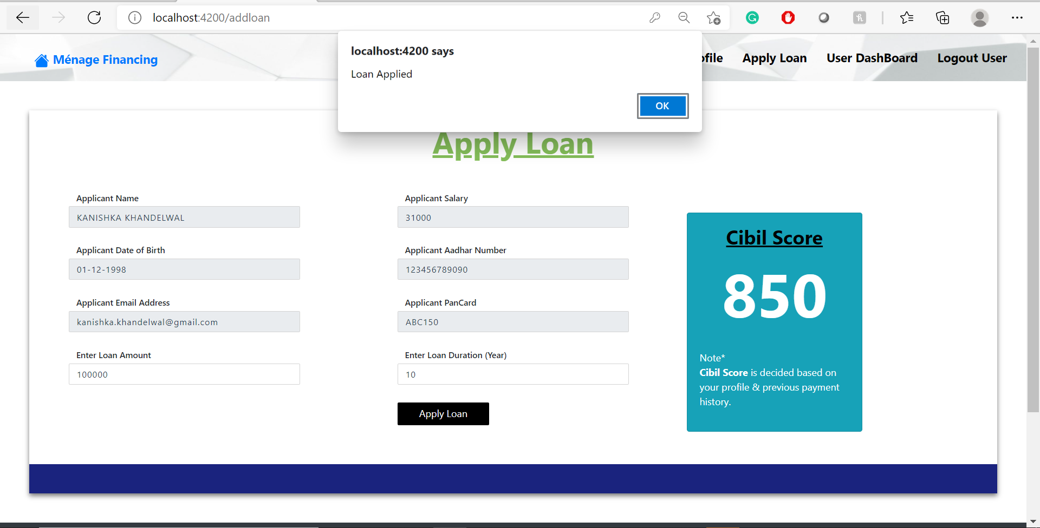

Slide 29
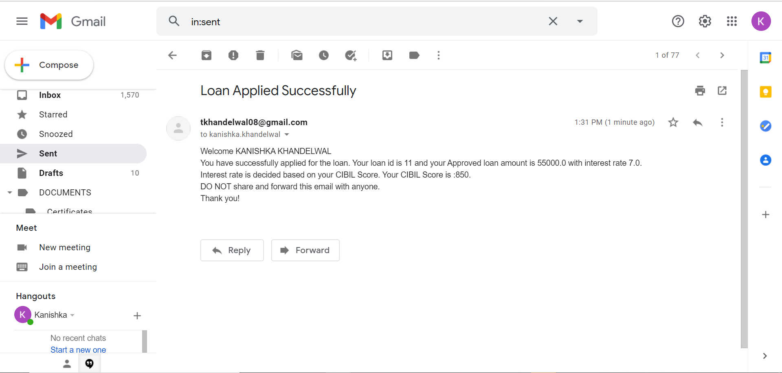

Slide 30
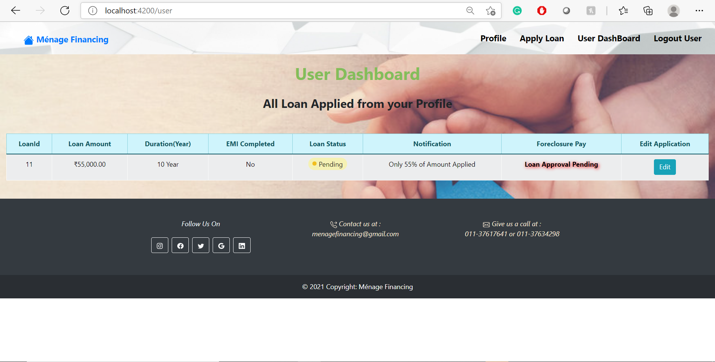

Slide 31
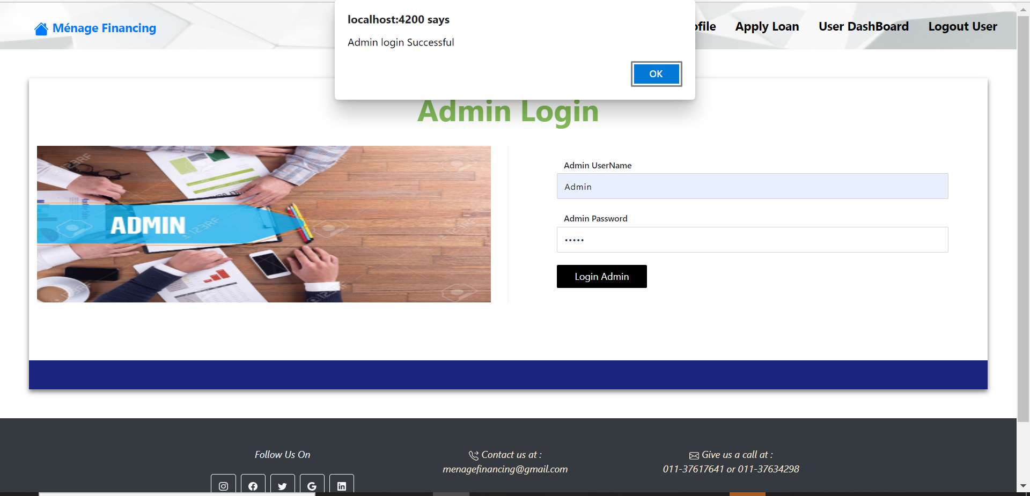

Slide 32
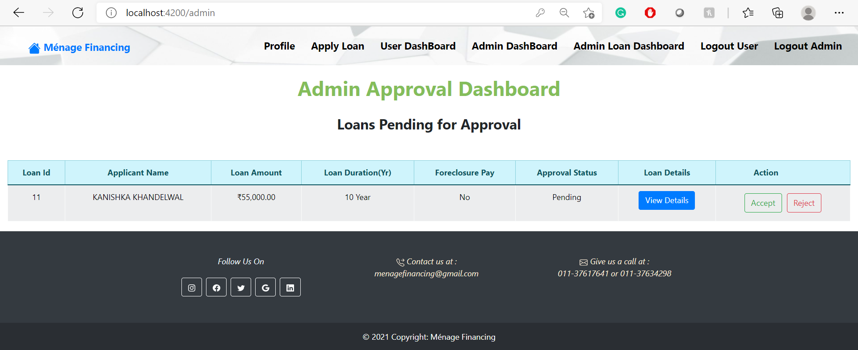

Slide 33
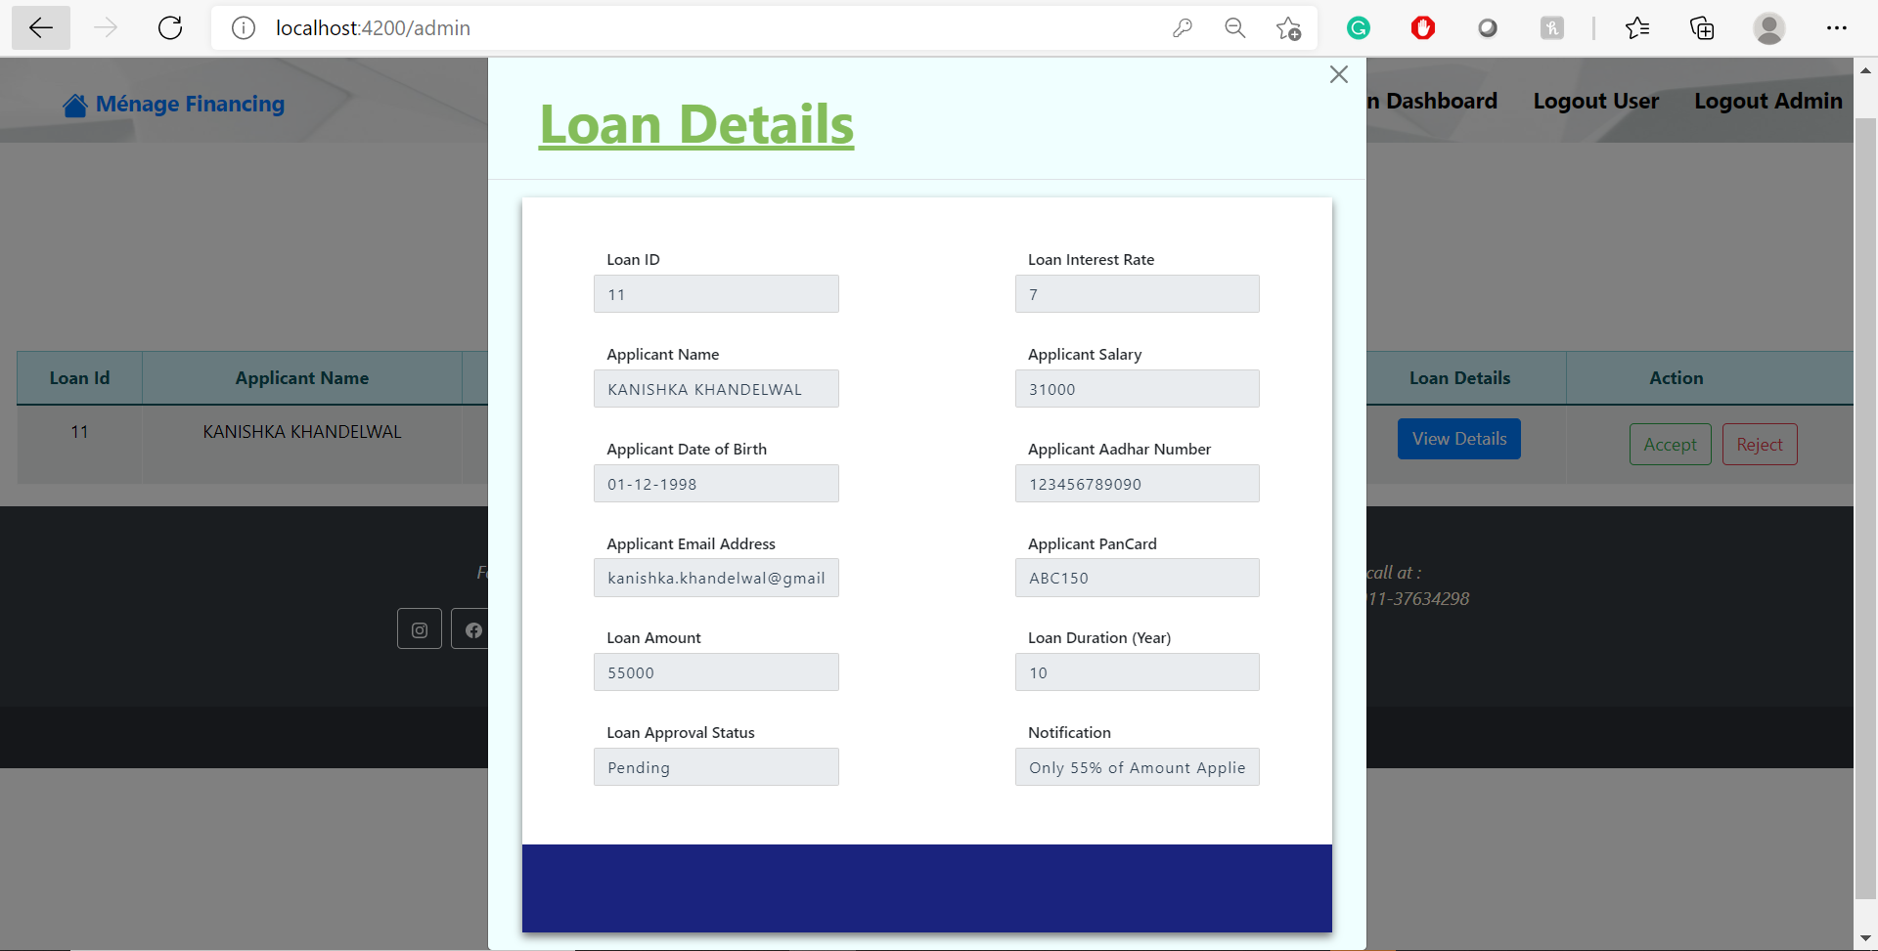

Slide 34
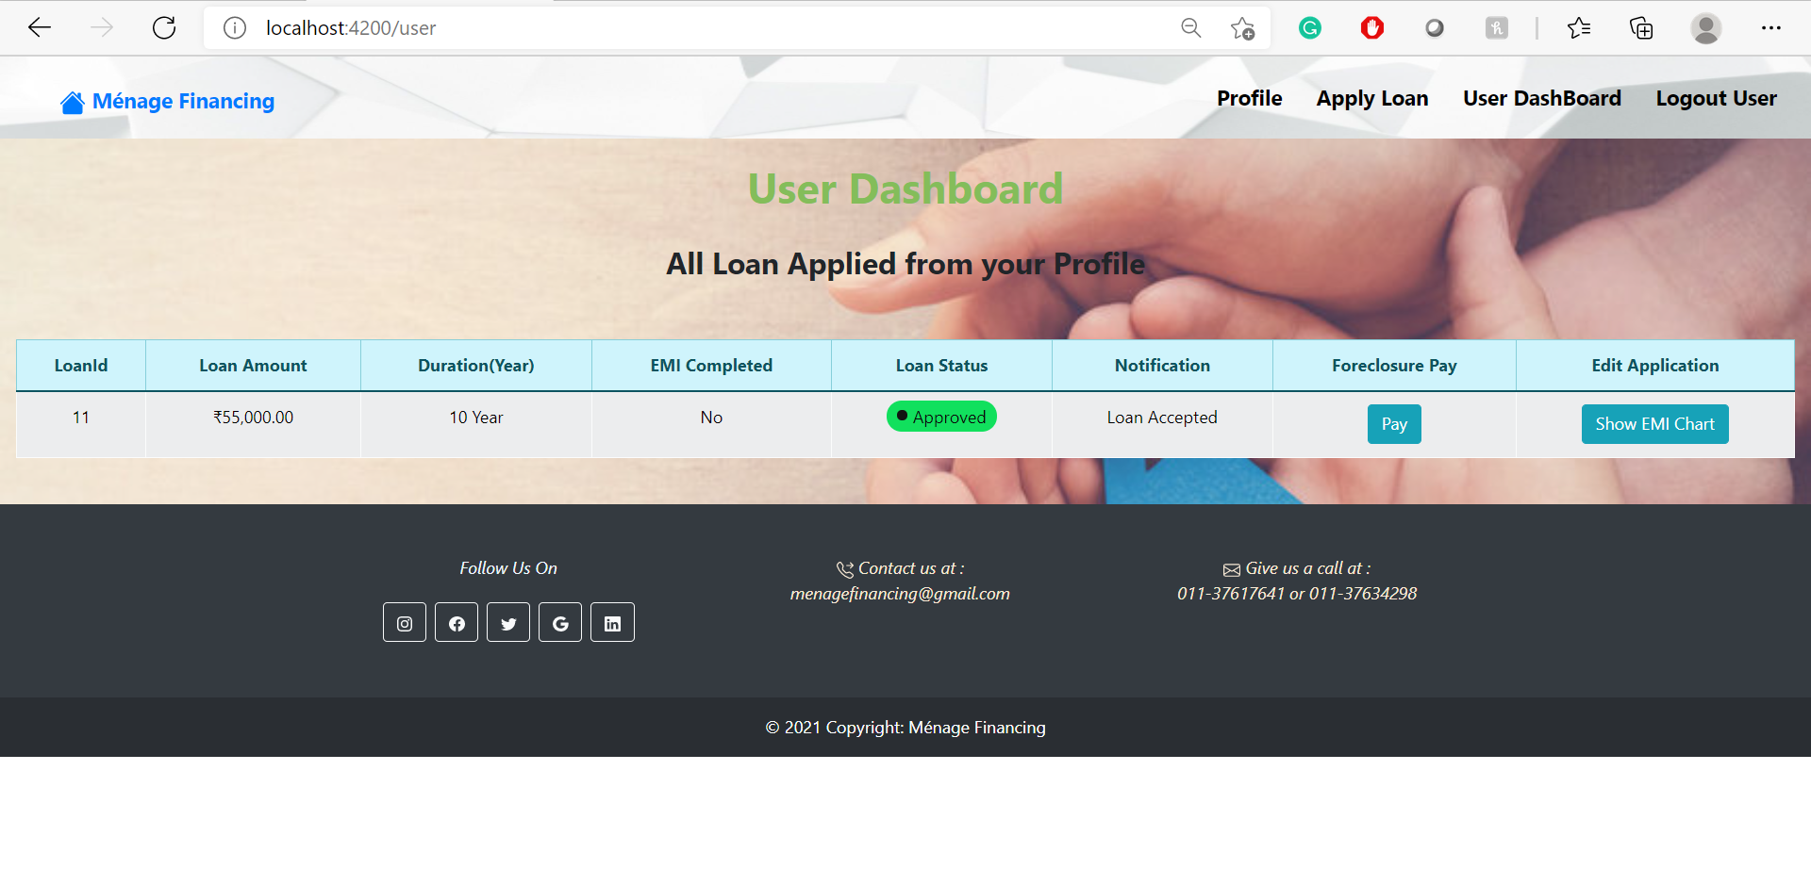

Slide 35
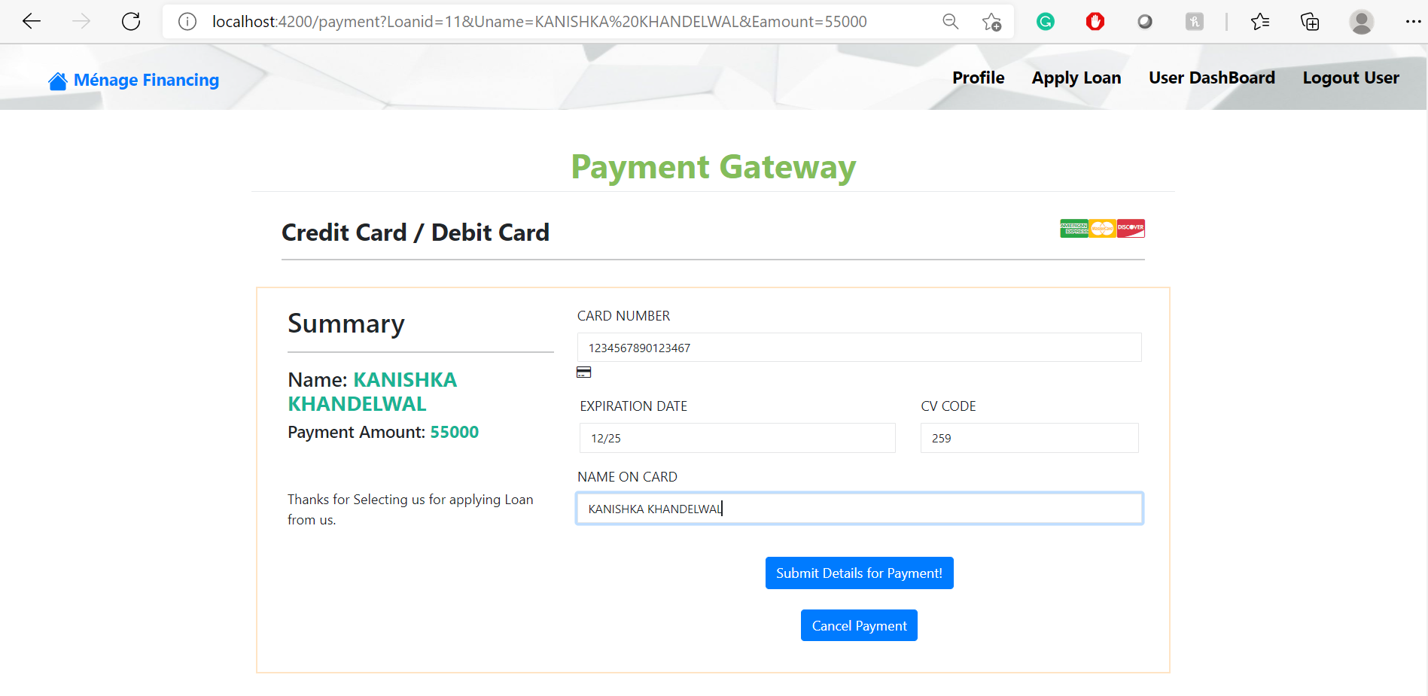

Slide 36
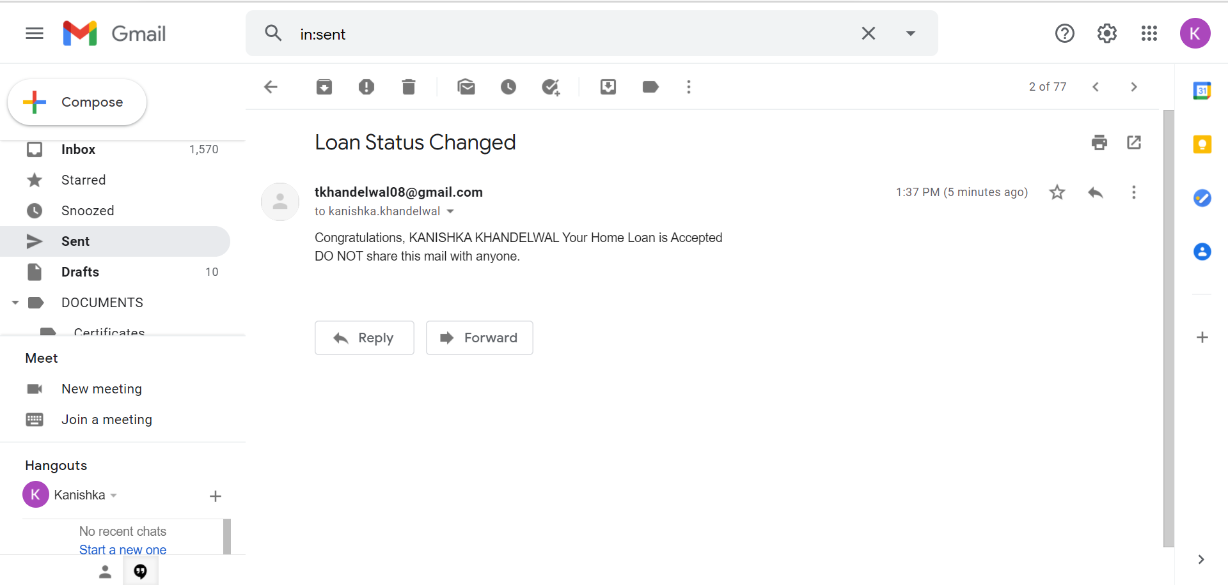

Slide 37
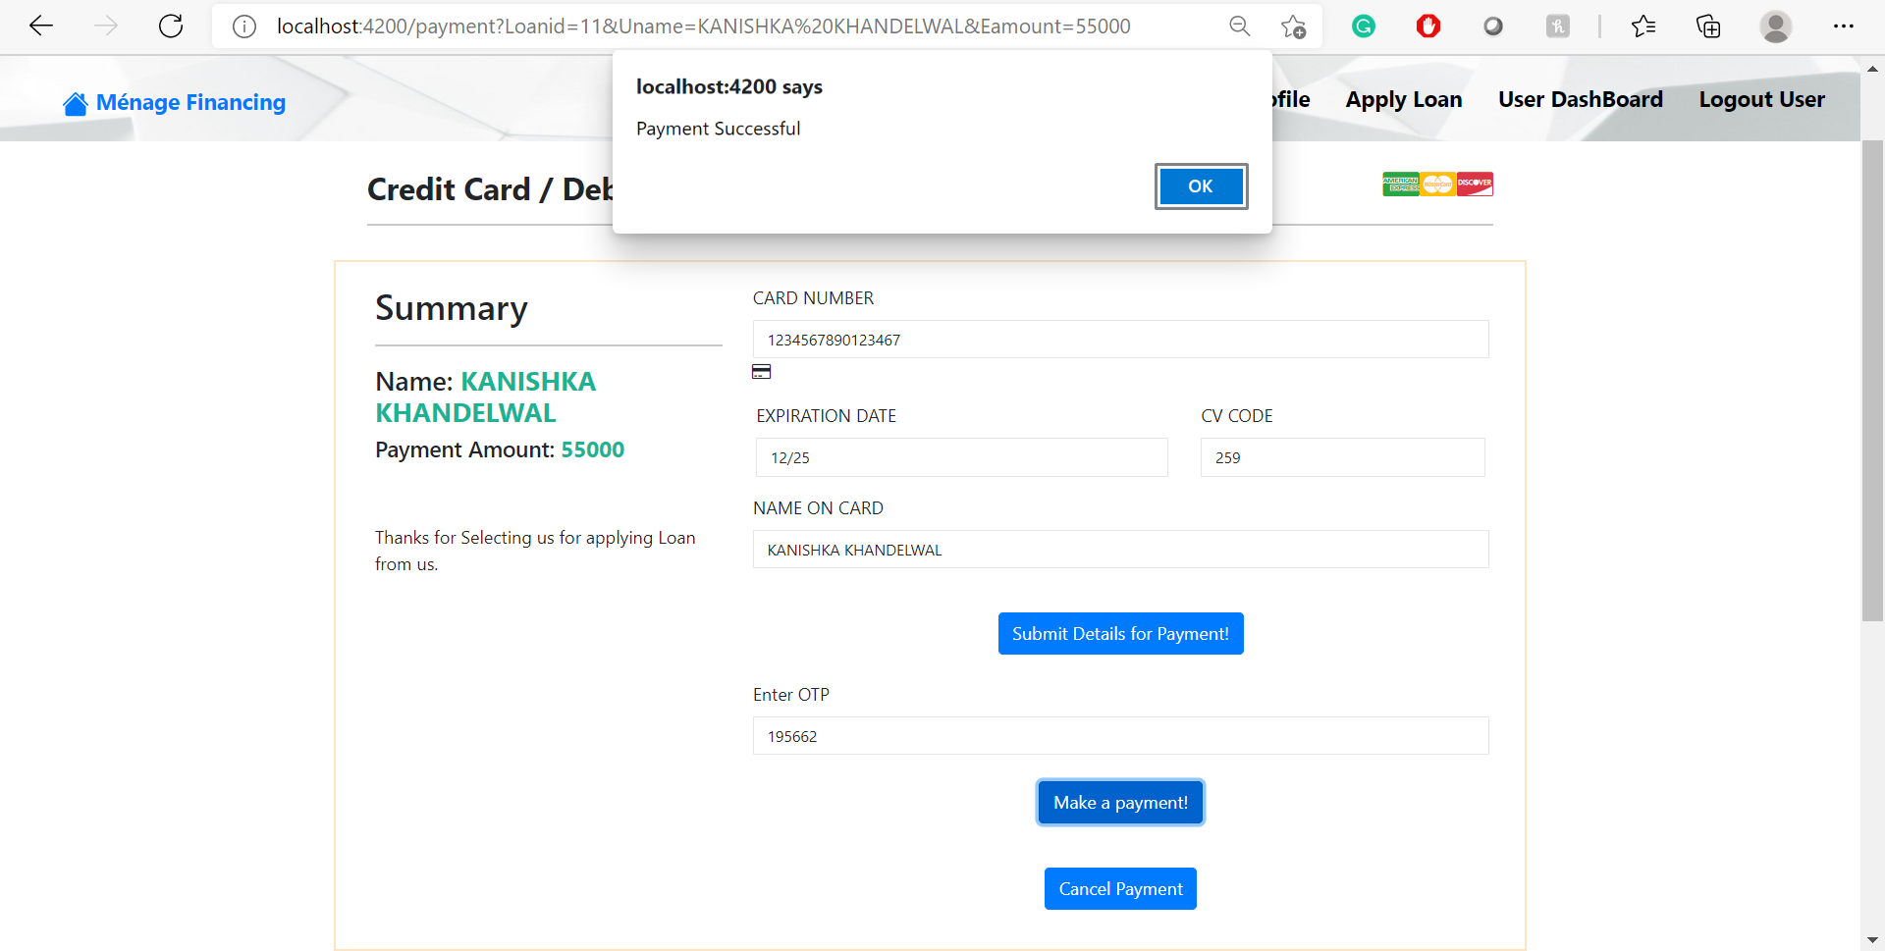

Slide 38
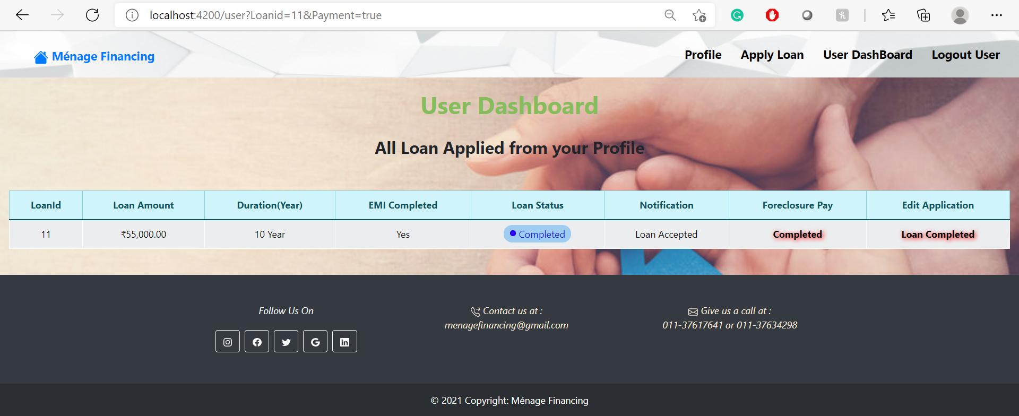

Slide 39


